Slide 1



Energy Monitoring and Benchmarking In Wastewater Treatment Plants Using the ENERWATER Approach
Dr Ana Soares
Senior Lecturer Cranfield University, UK
S Longo, M Mauricio-Iglesias, A Soares, P Campo, F Fatone, J M Lema, A Hospido
www.cranfield.ac.uk
Notes:
Thank you Francesco and Robberta for the introduction. My Name is Ana Soares and I will be presenting the final output of a h2020 project that

Slide 2
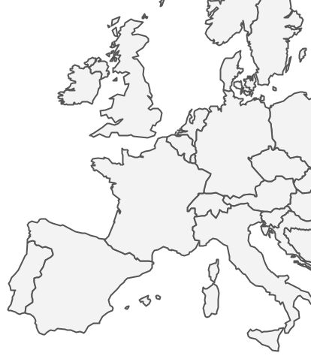














ENERWATER Project
The main objective is to develop, validate and to disseminate an innovative standard methodology for continuously assessing, labelling and improving the overall energy performance of Wastewater Treatment Plants (WWTPs).
44 months (March 2015 – October 2018)
1.7 MM €
Universidade de Santiago de Compostela (ES)
Università degli Studi di Verona (IT)
Università Politecnica delle Marche, Ancona
Cranfield University (UK)
Technical University of Cologne (DE)
Espina y Delfín (ES)
ETRA (IT)
Aggerverband (DE)
AENOR (ES)
Wellness Smart Cities (ES)
Notes:
The ENERWATER Project is funded by the European Commision under the H2020 programme and Cranfield University is lucky to work with Partner such as ….
The aim of the Project is to:

Slide 3
The final goal…
Universally understood energy label
Water Treatment Energy Index (WTEI)
Standardized: to allow sound comparisons between different plants and operators
Generic: Adapted to different typologies of WWTPs
Open: Anyone must be capable of using it and understand how the results are obtained.
Notes:
This type of annotation

Slide 4
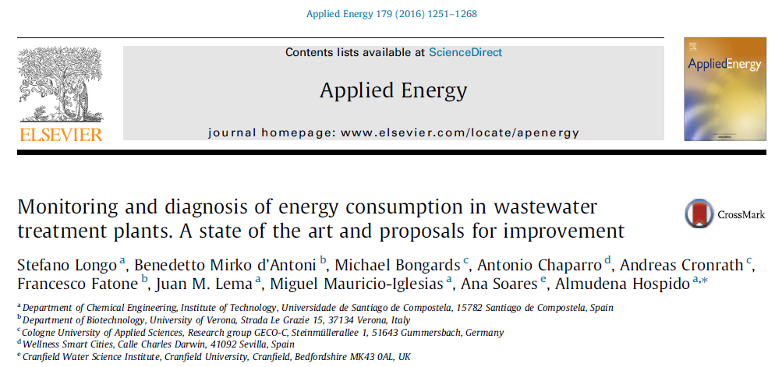
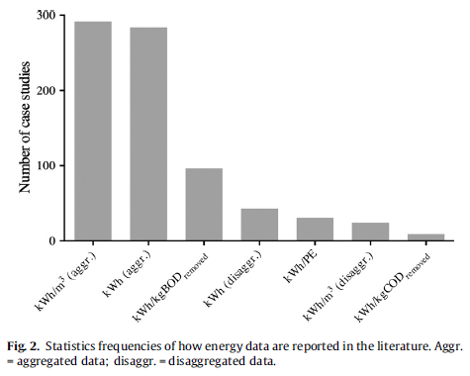
State of the art
WWTPs energy benchmarking methods applied so far in the wastewater sector (Data Envelopment Analysis or USEPA Energy Star method) can be used for comparison but they fail at prescribing any improvement strategy
Notes:
On the first steps of the Project was to understand the current state of the art on the energy monitoring and bechmarking methods.
Most of the data available is presented as the kWh/m3 etc
Most is agregated data, meaning that there is a single figure that presented for the whole WWTP
There is very litle information in literature about considering stages of treatment or even the types of pollutants removed.
as consequnece most of the methods so far have limited used both in terms of benchmarking or defening a strategy of improving energy consumption

Slide 5
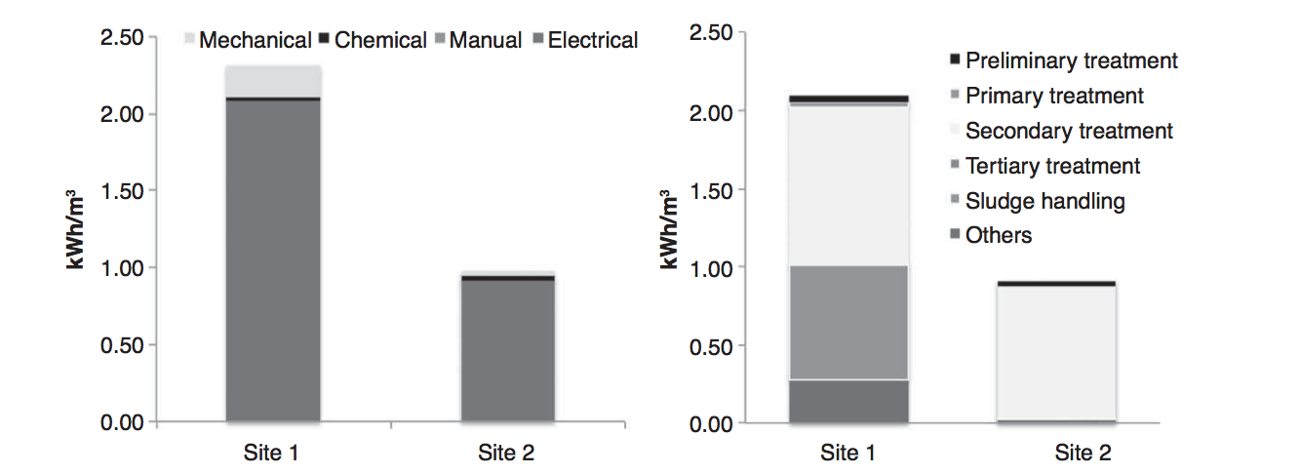
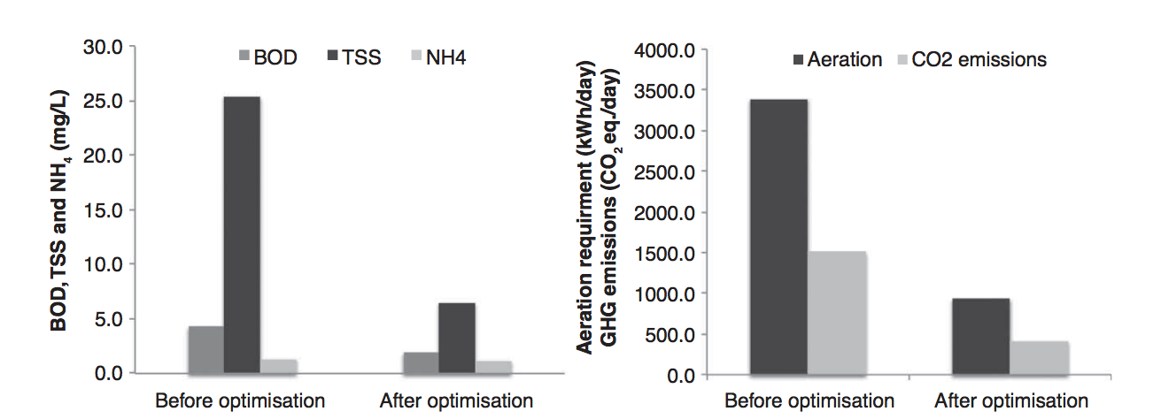
Energy benchmarking – case study
Energy benchmarking in kwh/m³ was not useful to compare sites or optimize energy consumption
Site 2 was optimized by installing a primary settling tank (payback 5-8 years)
Notes:
I give you an example….
2 site in the UK, both around the same PE, and both utilizing Oxidation ditches as secondary treatment.
At first glance – Site 2 seems much more efficient ..
But when looking in more detail – site 2 was very close to failing consent on COD and very often on nitrification. Whilst site 1 was working like a dream!
So this deeper knowledge on both sites lead to action being taken on Site 2 –
This showed us that considering just energy consumtion based on PE or m3 is a false benchmarking strategy – as this comparison doesn’t take in consideration the actual FUNCTION of the WWTP – the effluent quality that is obtained is directly related wih the energy consumption – bu still to date most energy benchmarking exercises do take this into consideration

Slide 6
WWTPs classification according to function
Type 1: Discharge to non-sensitive - this includes WWTPs focused on the removal TSS, BOD and COD (and NH₄)
Type 2: Discharge to sensitive areas - this includes WWTPs focused on removing TSS, BOD, COD, total phosphorus ammonia (NH₄) and nitrate (NO₃)
Type 3: Discharge for re-use (pathogens) - this includes WWTPs focused on removing TSS, BOD, COD, total phosphorus ammonia (NH₄) and nitrate (NO₃)
Key European Directives linked wastewater effluent discharges into waterways:
Urban Waste Water Treatment Directive (UWWTD) (91/271/EEC)
Nitrates Directive (ND) (91/676/EEC)
Water Framework Directive (WFD) (2000/60/EC)
Bathing Water Treatment Directive (2006/7/EC) replacing (76/160/EEC)
Shellfish Directive (79/923/EEC)
Freshwater Fish Directive (78/659/EEC)
Rodriguez-Garcia et al. (2011) Water Res 45, 5997

Slide 7
Other factors that influence performance were also considered
Sludge imports
Renewable energy produced on WWTP
Various types of energy used (electricity, diesel, natural gas etc.)
Chemicals used (chemical energy consumption - obtained from Ecoinvent database)

Slide 8
ENERWATER methodology
2 tools: Rapid Audit and Decision Support
 | Rapid Audit Methodology | Decision Support Methodology
Energy consumption data | Aggregated energy consumption from energy bills | Disaggregated online data from energy meters on site
Plant operation data | Routine influent/effluent analyses | Intra-sectional influent/effluent data
Objective | Energy benchmark Rapid tool to energy efficiency assessment | Diagnosis Understanding Verification Training tool
Notes:
Our first proposal was a methodology that required: , an inventory of the electrical equip on the whole site, installation of electivity meters, extensive sampling of the whole WWTP in between p

Slide 9
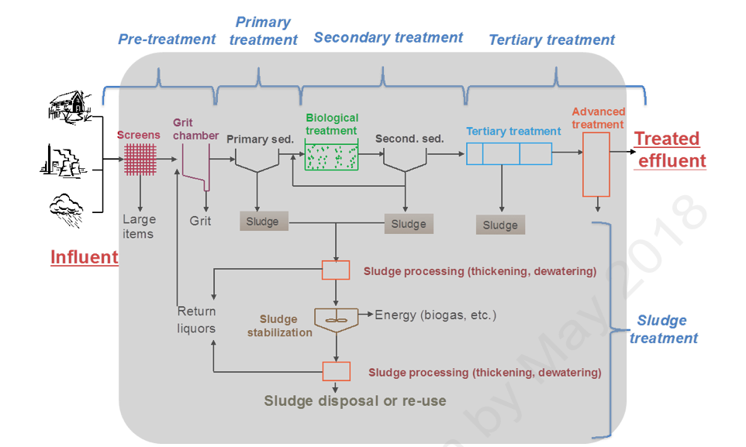
Rapid Audit:
WWTPs boundaries, KPIs and
Weightings (example)
Weights of different KPIs according to the average contribution of each function to the overall energy consumption of a WWTP
KPI | KPI₁ (kWh/m³) | KPI₂ (kWh/kg TPE_{rem}) | KPI₃ (kWh/log Reduction·m³) | KPI₄ (kWh/kg TSS)
Value (w_{i}) | 0.1191 | 0.5346 | 0.1214 | 0.2249
KPIs for overall plant and Rapid Audit methodology (database)
KPI # | KPI units | Average | Std. deviation | 90 percentile (P₉₀) | 10 percentile (P₁₀) | Number of data
KPI₁ | kWh/m³ | 0.348 | 0.445 | 0.901 | 0.161 | 97
KPI₂ | kWh/kg TPE_{rem} | 0.488 | 0.292 | 0.731 | 0.171 | 87
KPI₃ | kWh/(logReduction·m³) | 0.058 | 0.076 | 0.137 | 0.030 | 53
KPI₄ | kWh/kg TS_{proc} | 2.074 | 2.165 | 5.231 | 0.824 | 89

Slide 10
Decision Support:
WWTPs boundaries and KPIs
KPI | Stage 1 | Stage 2 | Stage 3 | Stage 4 | Stage 5
Value (w_{i}) | 0.1191 | 0.0150 | 0.5196 | 0.1214 | 0.2249
 | KPI | Avera. | Std. deviat. | 90 percent. (P₉₀) | 10 percent.(P₁₀) | Numb. of data
1 | kWh/m³ | 0.048 | 0.039 | 0.101 | 0.009 | 97
2 | kWh/kg TS_{rem} | 0.028 | 0.030 | 0.055 | 0.007 | 64
3 | kWh/kg TPE_{rem} | 0.289 | 0.246 | 0.519 | 0.108 | 87
4 | kWh/(m³·Log_{red}) | 0.030 | 0.047 | 0.054 | 0.010 | 53
5 | kWh/kg TSE | 0.308 | 0.400 | 0.577 | 0.055 | 89
STAGE CLASSIFICATION | KPIs
STAGE 1 | kWh/m³
STAGE 2 | kWh/kg TSS_{removed}
STAGE 3 | kWh/kg COD_{removed} , kWh/kgTP_{removed} , kWh/kg TN_{removed} , kWh/kgNH4_{removed}
STAGE 4 | kWh/kg TSS_{removed,} kWh/kgNH4_{removed} , kWh/kg TN_{removed} , kWh/kgTP_{removed} , kWh/Log _{reduction}
STAGE 5 | kWh/kg TS_{processed,} kWh_{produced}/kgVS_{removed}
STAGE 6 | kWh/kgTP_{removed} , kWh/kg TN_{removed}
STAGE 7 | kWh/kg VOCs _{removed}, kWh/kg VICs _{removed}, kWh/kg VSCs _{removed},

Slide 11
Water Treatment Energy Index (WTEI) calculation

Slide 12
Rank and assigning labels
The boundaries between labels have been decided according to the following criterion, common in EU efficiency labelling standards: the median performance index is the upper boundary of class D. This labelling strategy allows good discrimination power at high efficiency, serving as an incentive for innovation.

Slide 13
Application of methodology: Case studies
 | Plant A | Plant B | Plant C
ENERWATER Typology | 3 | 2 | 3
Capacity | 25,000 PE | 9,360 PE | 48,000 PE
Pre-treatment | Coarse screening, grit and grease removal | Storm water tank, coarse screening, grit and grease removal | Fine screening, grit and grease removal
Primary treatment | - | Primary sedimentation | -
Secondary treatment | Oxidation ditch, bio-P removal, secondary sedimentation | Activated sludge + chemical P precipitation, secondary sedimentation | Activated sludge + chemical P precipitation, secondary sedimentation
Tertiary treatment | - | - | UV disinfection
Sludge Treatment | Thickening, dewatering and disposal | Thickening, dewatering, disposal | Thickening, dewatering, disposal

Slide 14
Application of methodology: Case studies
Energy data:
Energy carrier | WWTP A | WWTP B | WWTP C
Electric energy [kWh/d] | 759,321 | 522,557 | 769,016
Natural gas [Scm/d] | - | - | -
Biogas [Scm/d] | - | - | -
Chemicals [kWh/d] | 1,503 | 18,497 | 55,006
Total energy [kWh/d] | 759,534 | 541,054 | 824,022
Operational data:
 | WWTP A |  | WWTP B |  | WWTP C
Parameter | Influent | Effluent | Influent | Effluent | Influent | Effluent
Flow [m³] | 1,730,329 |  | 1,791,271 |  | 5,760,845
COD [mg/L] | 255.00 | 50.00 | 305.53 | 10.40 | 308.00 | 22.00
TN [mg/L] | 22.00 | 4.00 | 30.06 | 0.06 | 36.60 | 6.40
TP [mg/L] | 7.20 | 2.60 | 4.63 | 0.46 | 4.63 | 0.57

Slide 15
Application of methodology: Case studies
Rapid Audit analysis: Evaluate and compare WWTP efficiency
 | WWTP A | WWTP B | WWTP C
EPI 1 | 0.136 | 0.136 | 0.119
EPI 2 | 0.608 | 0.608 | 0.535
EPI 3 | - | - | 0.121
EPI 4 | 0.256 | 0.256 | 0.225
WTEI | 0.226 | 0.143 | 0.745
Label | C | B | F
Plant C is a good candidate to for implementing energy saving measures.
Where do inefficiency come from???
Decision Support analysis: Evaluate and optimize processes within WWTP
 | WWTP A | WWTP B | WWTP C
Stage 1 | F | B | G
Stage 2 |  | C
Stage 3 | C | C | F
Stage 4 |  |  | G
Stage 5 | B | B | A
Global Label | C | B | F
Plant A and C should look at their pumping station
Plant C has very likely a low efficient aeration system, as well as low efficient UV lamp

Slide 16
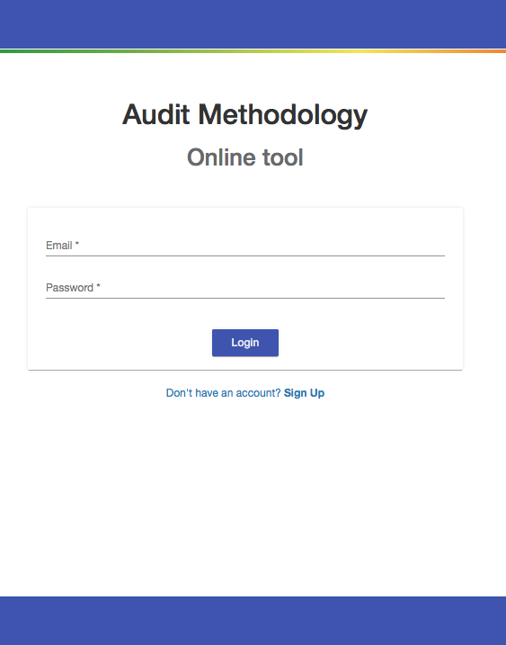
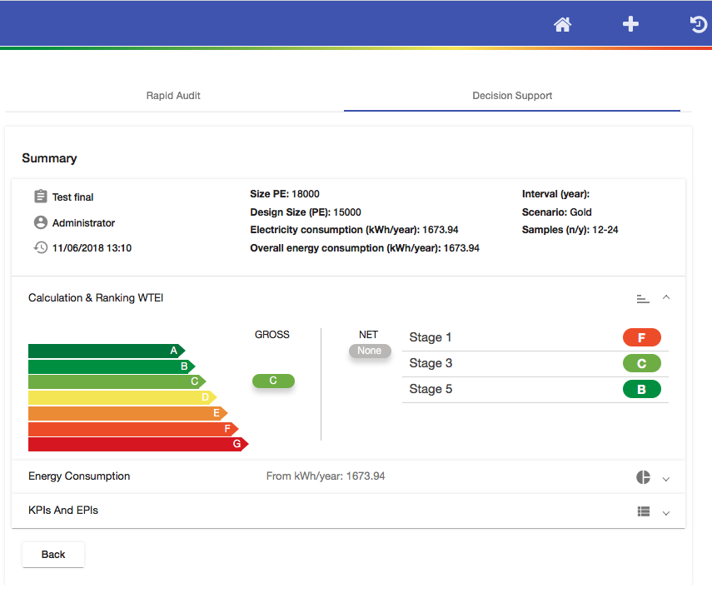
ENERWATER online tool is (almost) ready to use
ENERWATER methodology: http://www.enerwater.eu/download-documentation/
ENERWATER online tool: https://enerwater-h2020.wtelecom.es
Register here

Slide 17



ENERWATER evolving to an European Standard
ENERWATER is proposing a new standard for WWTP energy efficiency
ENERWATER methodology
Technical report
European standard
Preparing report jointly with Working Group 40
To be voted by
CEN/TC-165 members

Slide 18


www.enerwater.eu
ENERWATER Project
@EnerwaterPro
Acknowledgements & Disclaimer:
The ENERWATER project has received funding from the European Union’s Horizon 2020 research and innovation programme under grant agreement No 649819 (H2020-EE-2014-3-MarketUptake). Although the project's information is considered accurate, no responsibility will be accepted for any subsequent use thereof. The EC accepts no responsibility or liability whatsoever with regard to the presented material, and the work hereby presented does not anticipate the Commission's future policy in this area.
Notes:
Picture from group

Slide 19


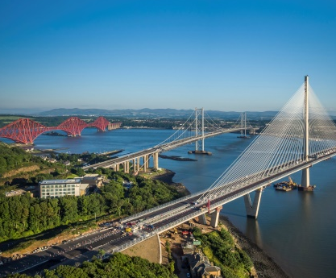
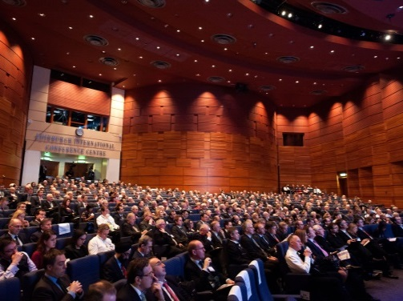



The 16th IWA Leading Edge Conference on Water and Wastewater Technologies
Join Us
10-14 JUNE 2019, EDINBURGH, UK
www.iwa-let.org
let@iwahq.org
#iwalet
Organized by:
Supported by:
Notes:
As head of the local organizer committee, It gives me great pleasure and personal joy to stand here today and invite you to attend the 16th IWA Leading Edge Conference on Water and Wastewater treatment 2019.
The conference will take place on the 10-14 June in the beautiful city of Edinburg, in Scotland in the United Kingdom.

